Slide 1



Slide 2

Professional (Academic) Credentials
Pursuing Masters of Business Law (MBL) PACE – Professional & Continuing Education @ NLSIU (National Law School of India University)
Financial Planning Standards Board, India (subsidiary of FPSB, USA)
  Certified Financial Planner®
Dale Carnegie Certified Trainer
PG Certificate programs @ IIM-Calcutta (Strategic Management) & XLRI – Human Resource Management
Indian Institute of Banking & Finance
  Diploma in Banking & Finance
Coach for Life Institute, USA (ICF empaneled Education Provider)
    Resourcefulness Coach

Slide 3
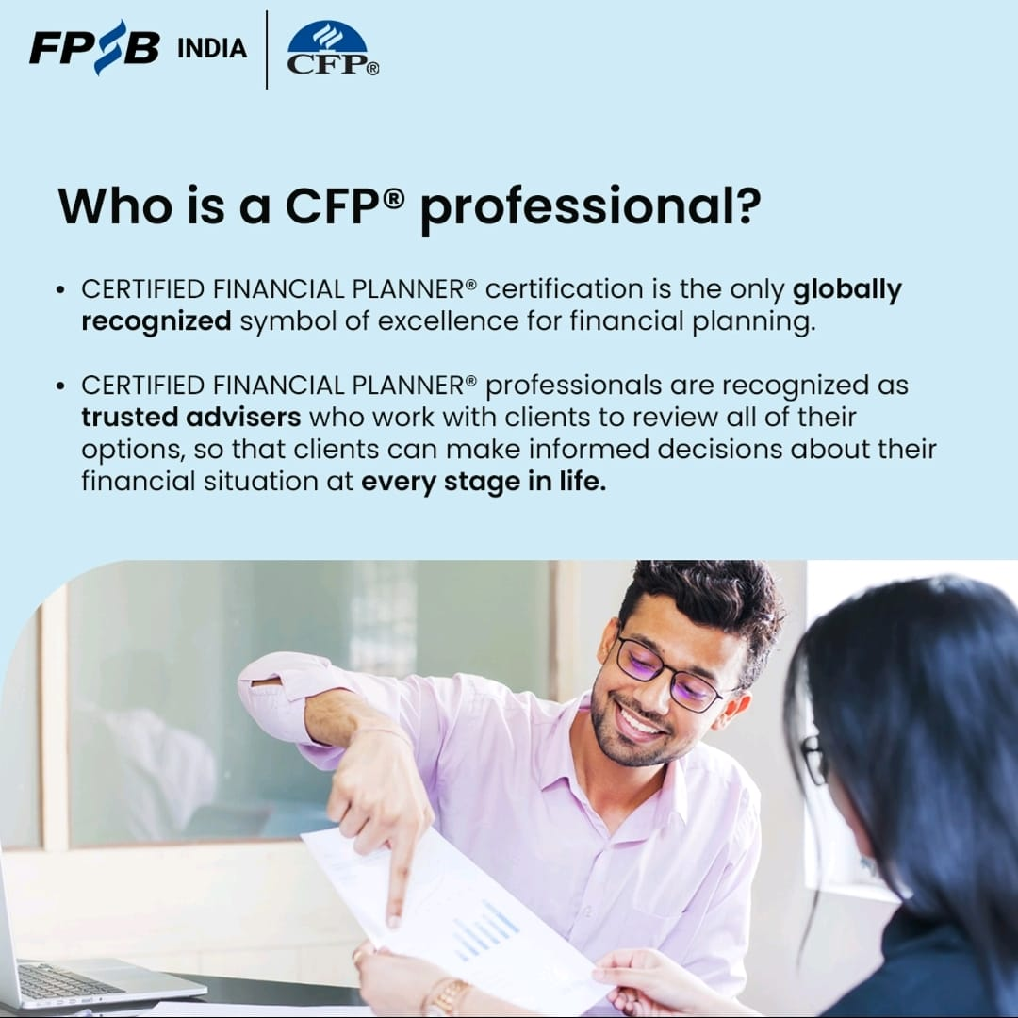
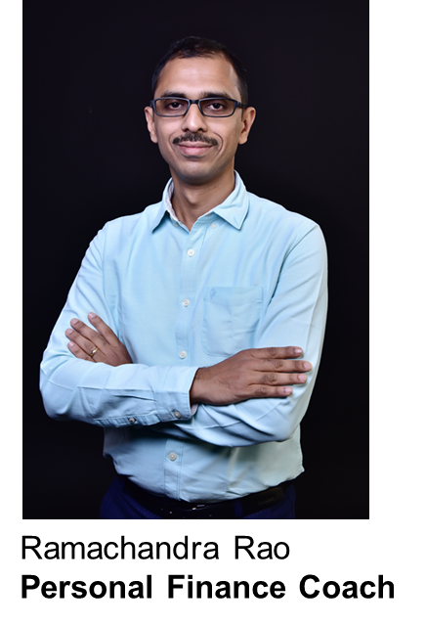

Slide 4

Industry Experience
Associate Regional Manager (Karnataka) - Corporate Business (Gratuity, Superannuation & NPS fund management business) @ ICICI Prudential Life Insurance Co. Ltd between 2012 to 2017
Channel Sales Manager (Bangalore) - Unsecured & SME Business Loans @ Barclays Finance between 2008 to 2011
Business Manager (Personal Loans) @ Kotak Mahindra Bank & ICICI Bank between 2005 & 2007
Family Business @ Library Supplies of Imported Academic Books (Medicine, STEM, HSS) Supplies between 2000 & 2004

Slide 5
Consultant Experience
Visiting Faculty – Jain Univeristy, Jayanagar 9th Block & ISBR Business School, Electronic City (teaching industry related topics to B.Com, BBA & PGDM students)
Conducted 200+ Investor Awareness Programs till date (pro bono and paid) in various corporates and educational institutions (online & offline)
Regional Business Support – Strategic Initiatives, Bancassurance (Axis Bank), Max Life Insurance Co. Ltd. Jan 2020 to Mar 2020
Consultant Trainer – Perfex Learning Partners, Mumbai, conducted various training programs @ client locations across India spanning industries like OMCs, Oil Marketing Companies – HPCL, Shell etc, BFSI - LIC, LIC Housing Finance, Kotak Mahindra Bank Ltd, Automotive – Nandi Toyota and many more
Consultant Trainer – HDFC Life Insurance Co. Ltd. Apr 2018 to Mar 2019

Slide 6
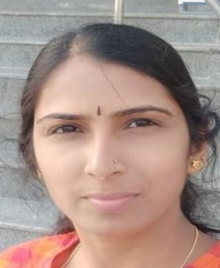
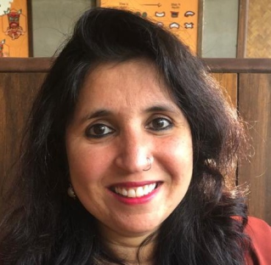
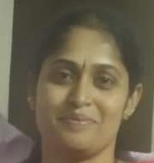
About Us
  Trusted by over 100+ families
  30cr+ AUMA (Assets Under Management across products)
  More than 6 years in business
  Process First, Plan next, Products Last
  Team of 4 – committed, competent and caring
  Fee-based Coaching (121 and One to Many)
  Investor Suitability based Product recommendation
Our Team

Slide 7
Asks
Junior, Mid & Senior Level Executives in Indian & MNCs
Academic Program Managers @ B-Schools
Founders of Micro, Small & Medium Enterprises (MSME) – who employ anywhere between 10 to 1000 employees
High end / Luxury Car Dealers (Toyota, BMW, Benz, JLR etc)
Mid & Senior level Professionals – CA, CS, Legal, Medicine, Engineering, Finance, HR

Slide 8
